Slide 1
Introduction to Trinidad and Tobago
Trinidad and Tobago is a small, twin-island country in the southern section of the Caribbean, just off the coast of Venezuela. Port of Spain, its capital, and other urban centers include San Fernando and Scarborough. It is home to about 1.4 million people of various ethnic groups, including those of African and Indian descent. It is a unitary parliamentary republic with English as the official language.
Trinidad and Tobago is among the Caribbean countries with the highest GDP per capita, mainly due to its strong energy industry. The GDP of the country in 2022 was approximately $25 billion USD, and per capita GDP was $17,000 USD. The economy depends on the production and export to foreign countries of oil and natural gas, which provide a hefty share of government revenue and foreign exchange earnings. Trinidad and Tobago is the Western Hemisphere’s fourth-largest natural gas exporter. Other key components of GDP are petrochemicals, LNG, fertilizers, and non-energy sectors like tourism, agriculture, and manufacturing.
Trinidad and Tobago pots boiling with color, Carnival the mood, and calypso and soca the music. On the leisure geographic perspective, it comprises stunning beaches, tropical jungles, and distinctive environments like the Caroni Marsh. Trinidad is bigger and more industrialized, while Tobago is more touristy and laid-back. Trinidad and Tobago is a relatively diversified economy, though global energy prices experience fluctuation, thanks to its established energy infrastructure and position in global markets.

Slide 2
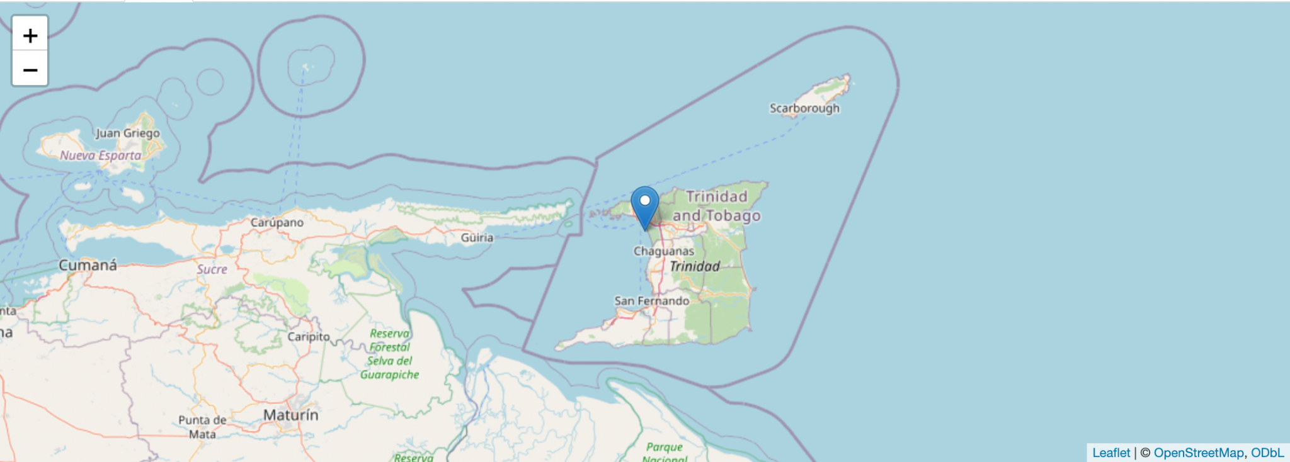
Map

Slide 3



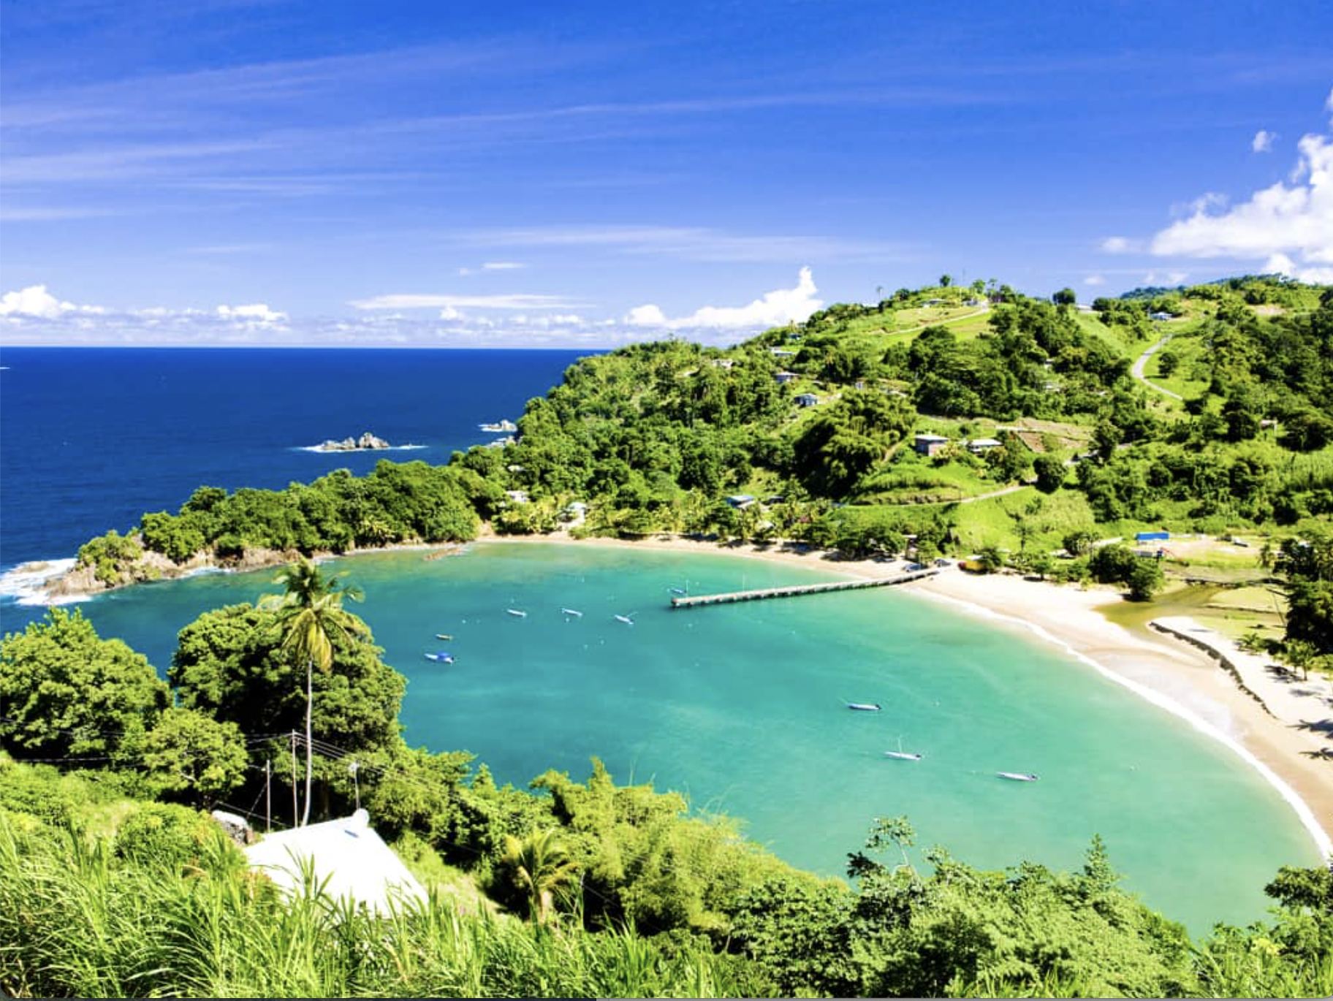
Tourist Attractions in Trinidad and Tobago

Slide 4
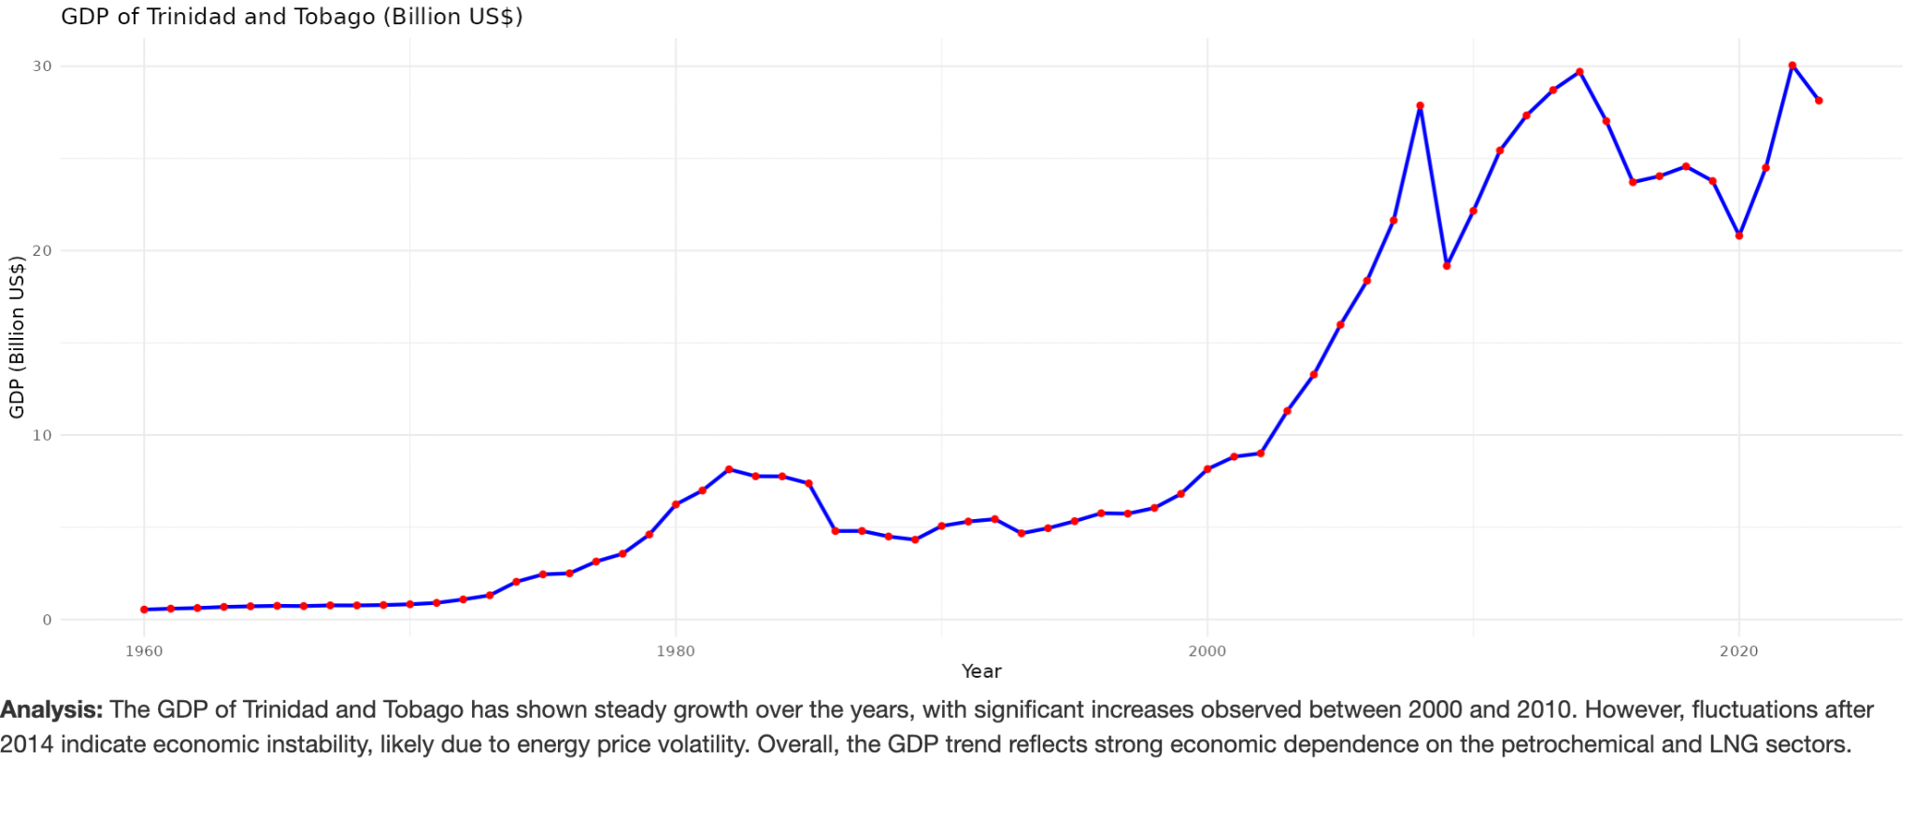
GDP data plot

Slide 5
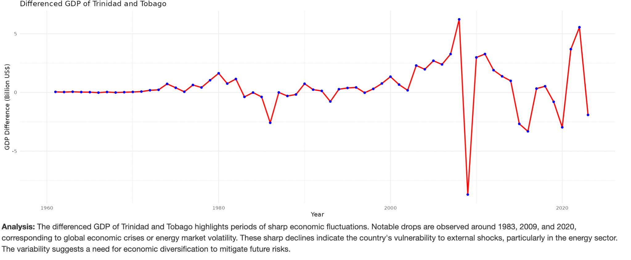
GD after Differencing

Slide 6
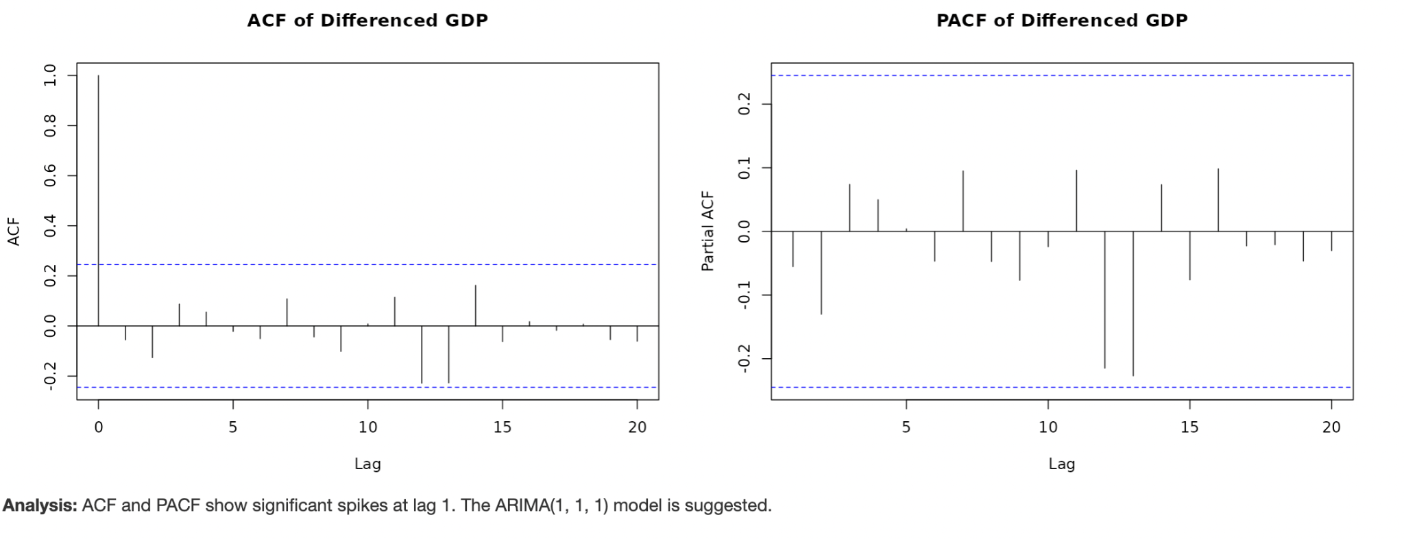
ACF and PACF

Slide 7
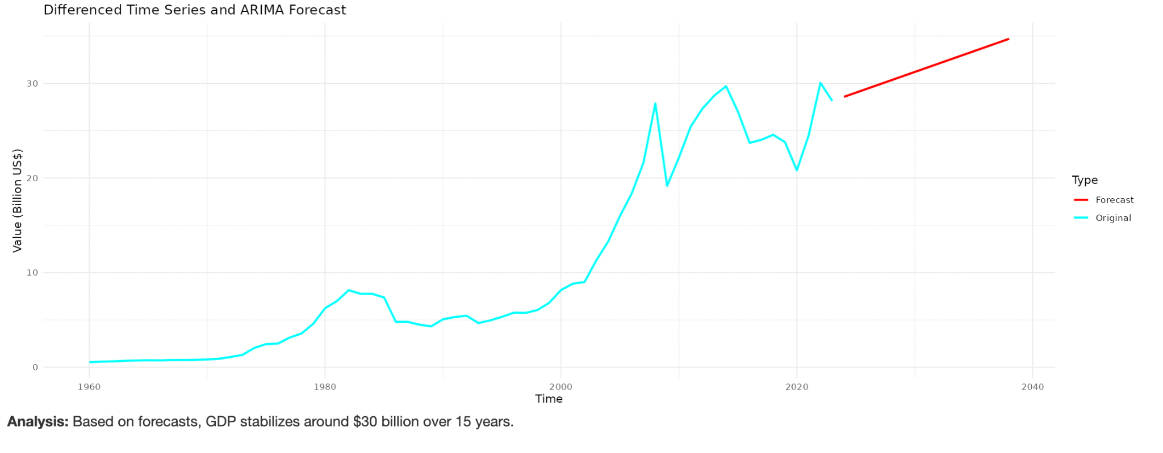
ARIMA Forecast

Slide 8
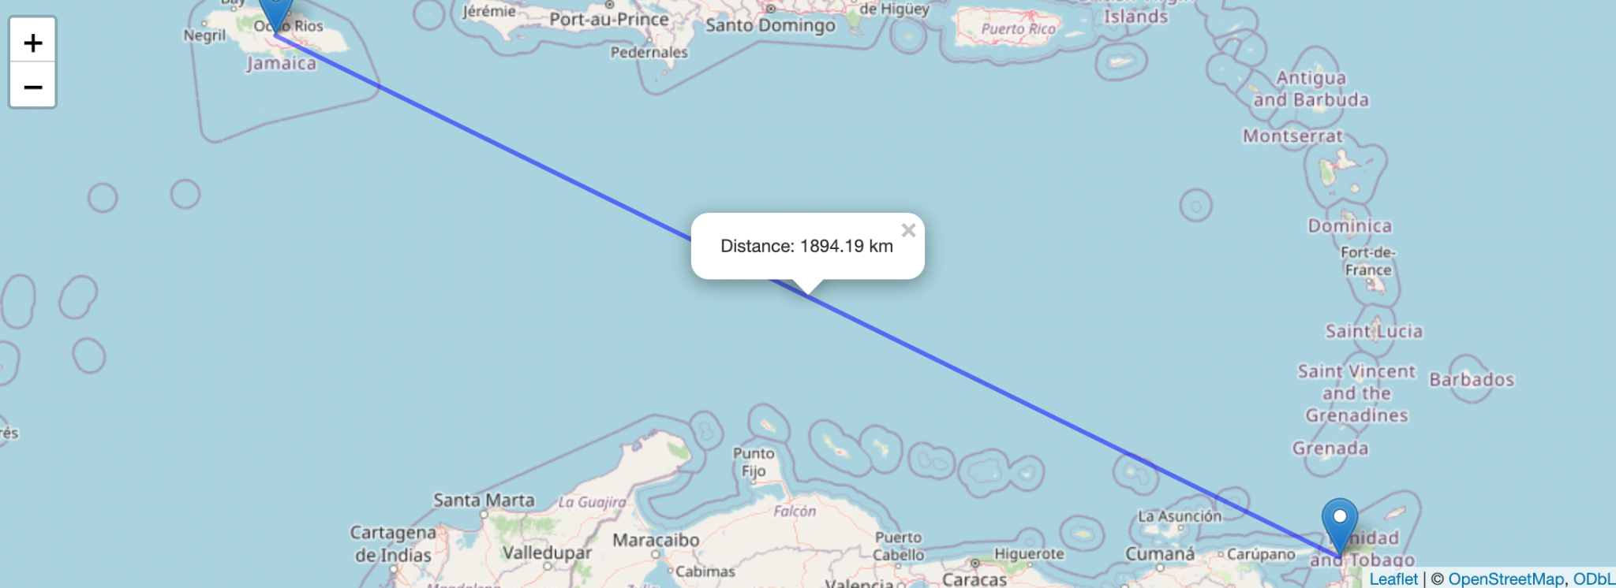
Jamaica to Trinidad & Tobago

Slide 9
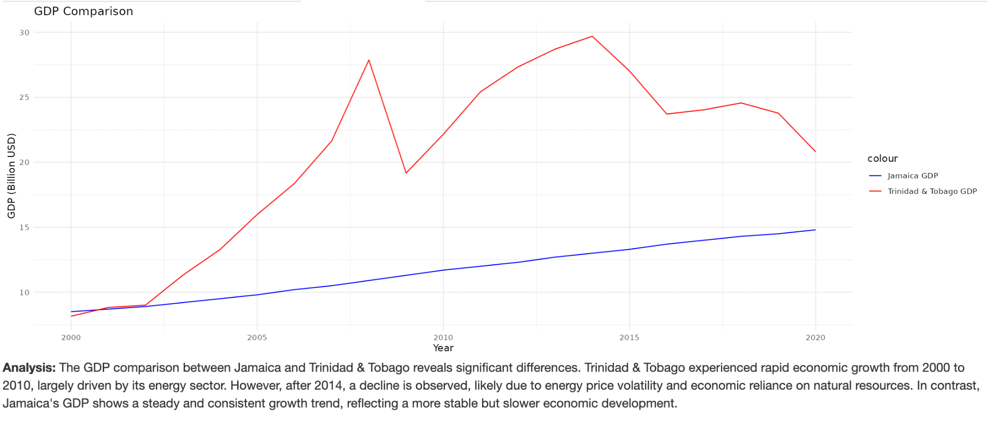
GDP Comparison

Slide 10
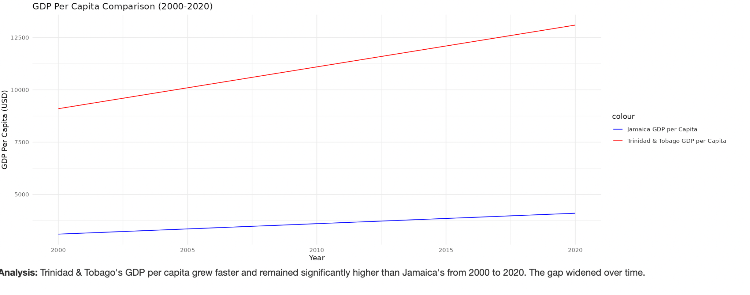
GDP per Capita

Slide 11
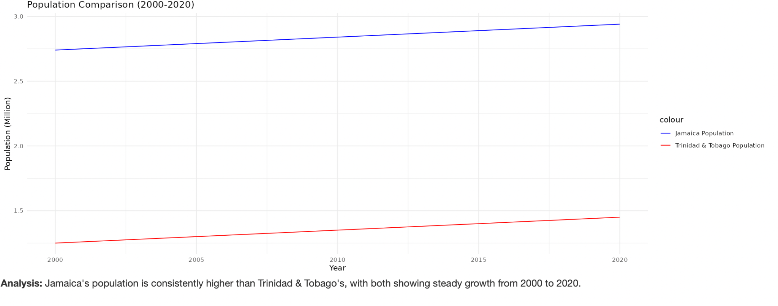
Population

Slide 12
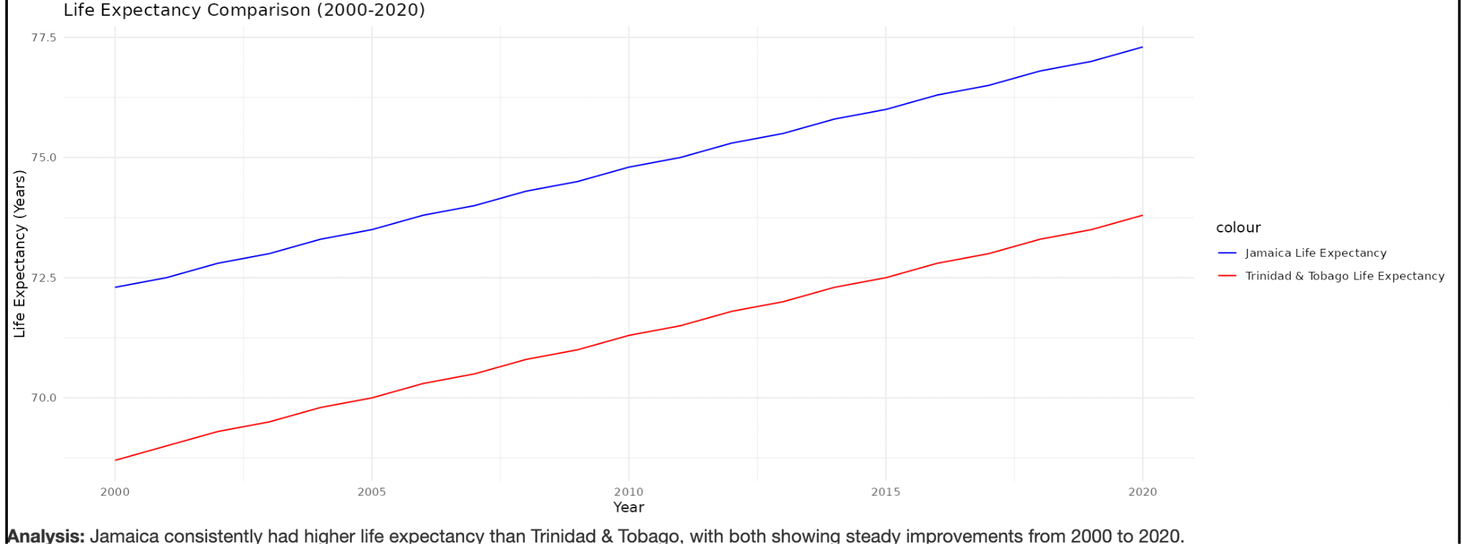
Life Expectancy

Slide 13
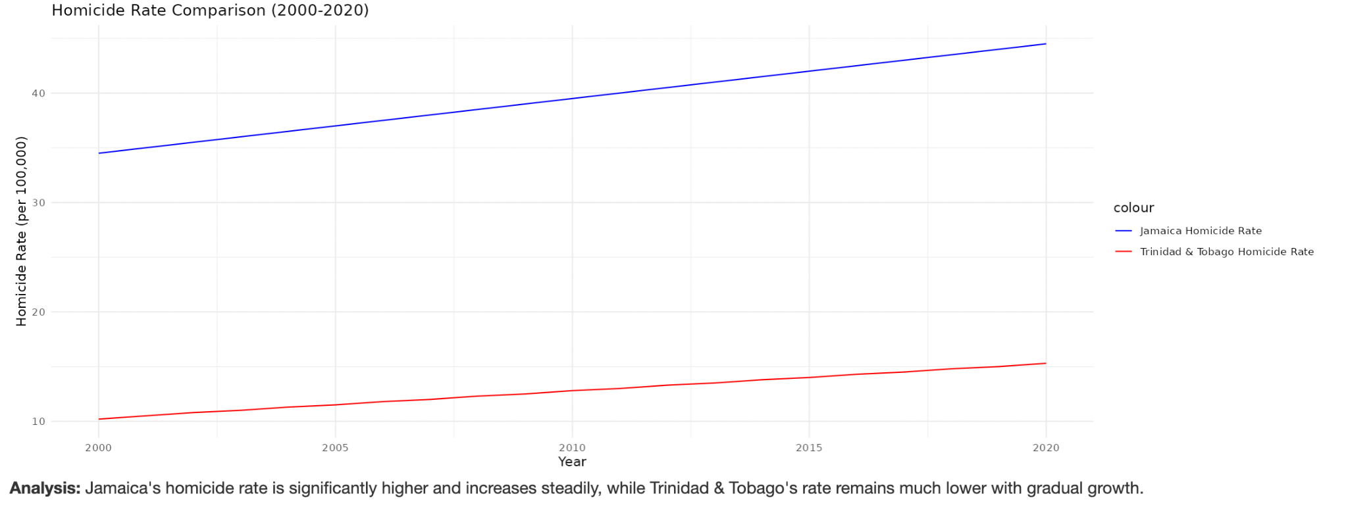
Homicide Rate

Slide 14
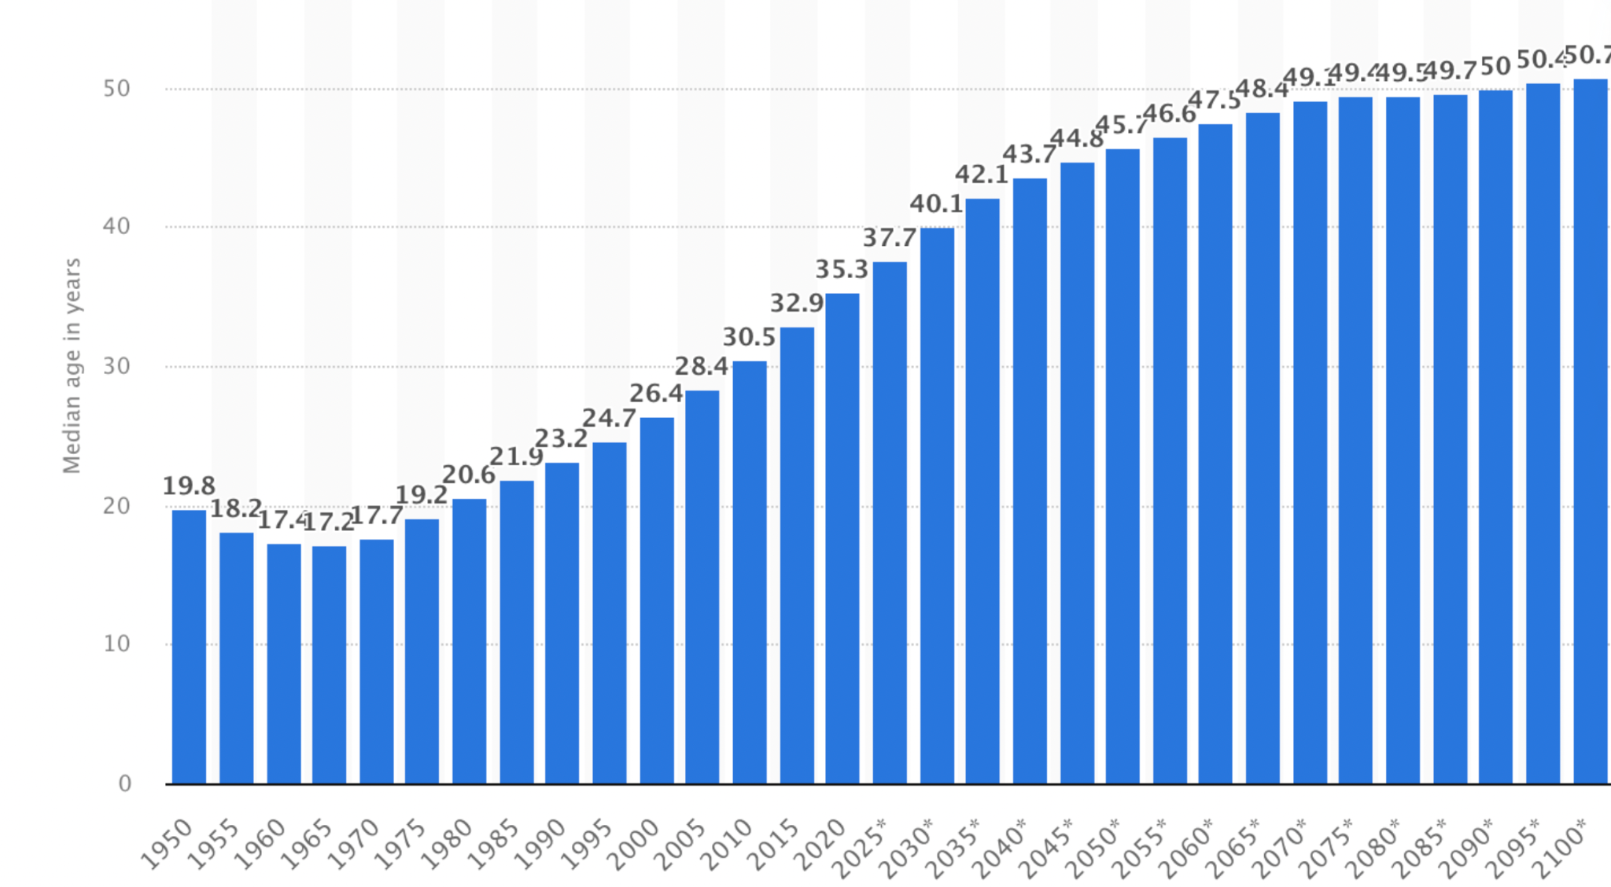
SWOT Analysis of Trinidad and Tobago
Strength
• Trinidad and Tobago's GDP continues to grow steadily, driven by its strong petrochemical and LNG sectors.
• High GDP per capita compared to other Caribbean nations reflects economic prosperity.
• Significant investments in renewable energy and infrastructure development.
Weakness
• Overdependence on energy exports makes the economy vulnerable to price fluctuations.
• An aging population increases healthcare costs and reduces the labor force.
Opportunities
• Expanding tourism and agriculture sectors can help diversify the economy.
• Leveraging its strategic location to attract foreign investments and trade opportunities.
Threats
• Global warming threatens coastal infrastructure and the tourism industry.
• Declining energy reserves pose long-term economic risks if diversification efforts fail.

Slide 15
Reference
Statista. (n.d.). Average age of the population in Trinidad and Tobago from 1950 to 2050. Statista. Retrieved December 16, 2024, from https://www.statista.com/statistics/728989/average-age-of-the-population-in-trinidad-and-tobago/

